Slide 1


STUDENT NAME: Dhudesh R
REGISTER NO :24bsca108
NMID: 1ECE8A97326AC83B9F54109734A664A7
DEPARTMENT: BCA
COLLEGE: Sri Krishna Adithya College of Arts and Science UNIVERSITY:Bharathiyar university

Slide 2


portfolio
M

Slide 3


Problem Statement
Project Overview
End Users
Tools and Technologies 5.Portfolio design and Layout
6.Features and Functionality
/.Results and Screenshots 8.Conclusion
9.Github Link
3/21/2024

Slide 4


My portfolio is a personal website that showcases my skills, projects, and contact details in a clean and structured layout

Slide 5

A simple, responsive, and user-friendly portfolio
Includes sections: About Me, Projects, and Contact
Designed to represent my professional profile

Slide 6



Recruiters and Interviewers
College Faculty Fellow Students
Anyone interested in my work

Slide 7


HTML5 for structure
CSS3 for design and styling JavaScript for interactivity
/

Slide 8

Clean and minimal UI
Sections arranged vertically for better navigation
Profile image and project cards for visual appeal
8

Slide 9


Scroll-to-section button
Responsive layout for all devices
Simple contact form with alert on submit

Slide 10

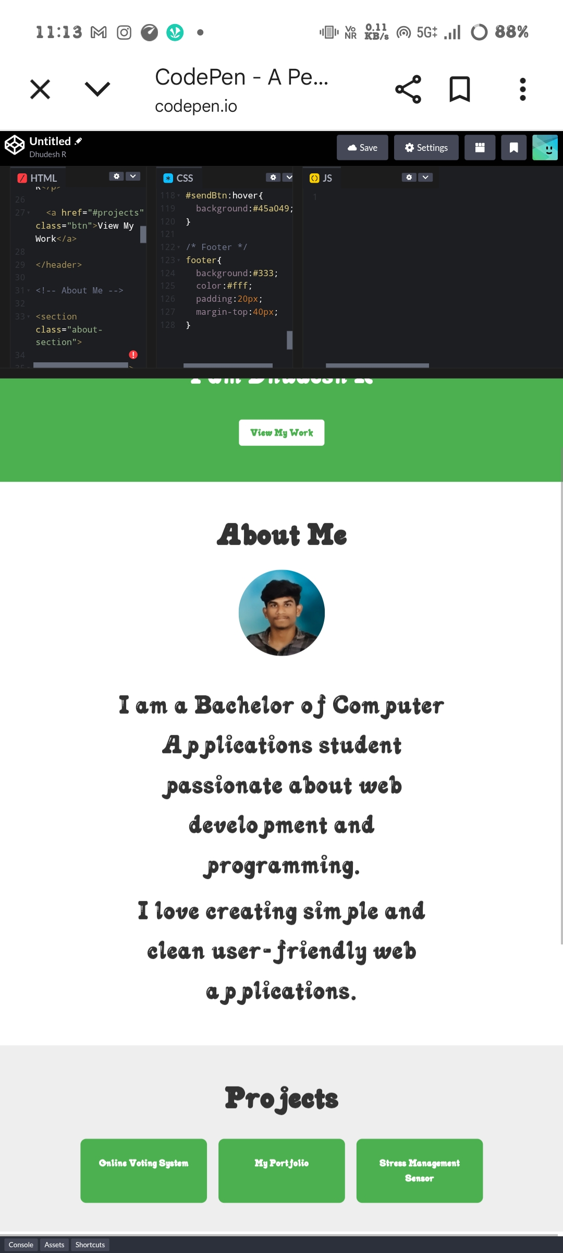

3/21/2024

Slide 11
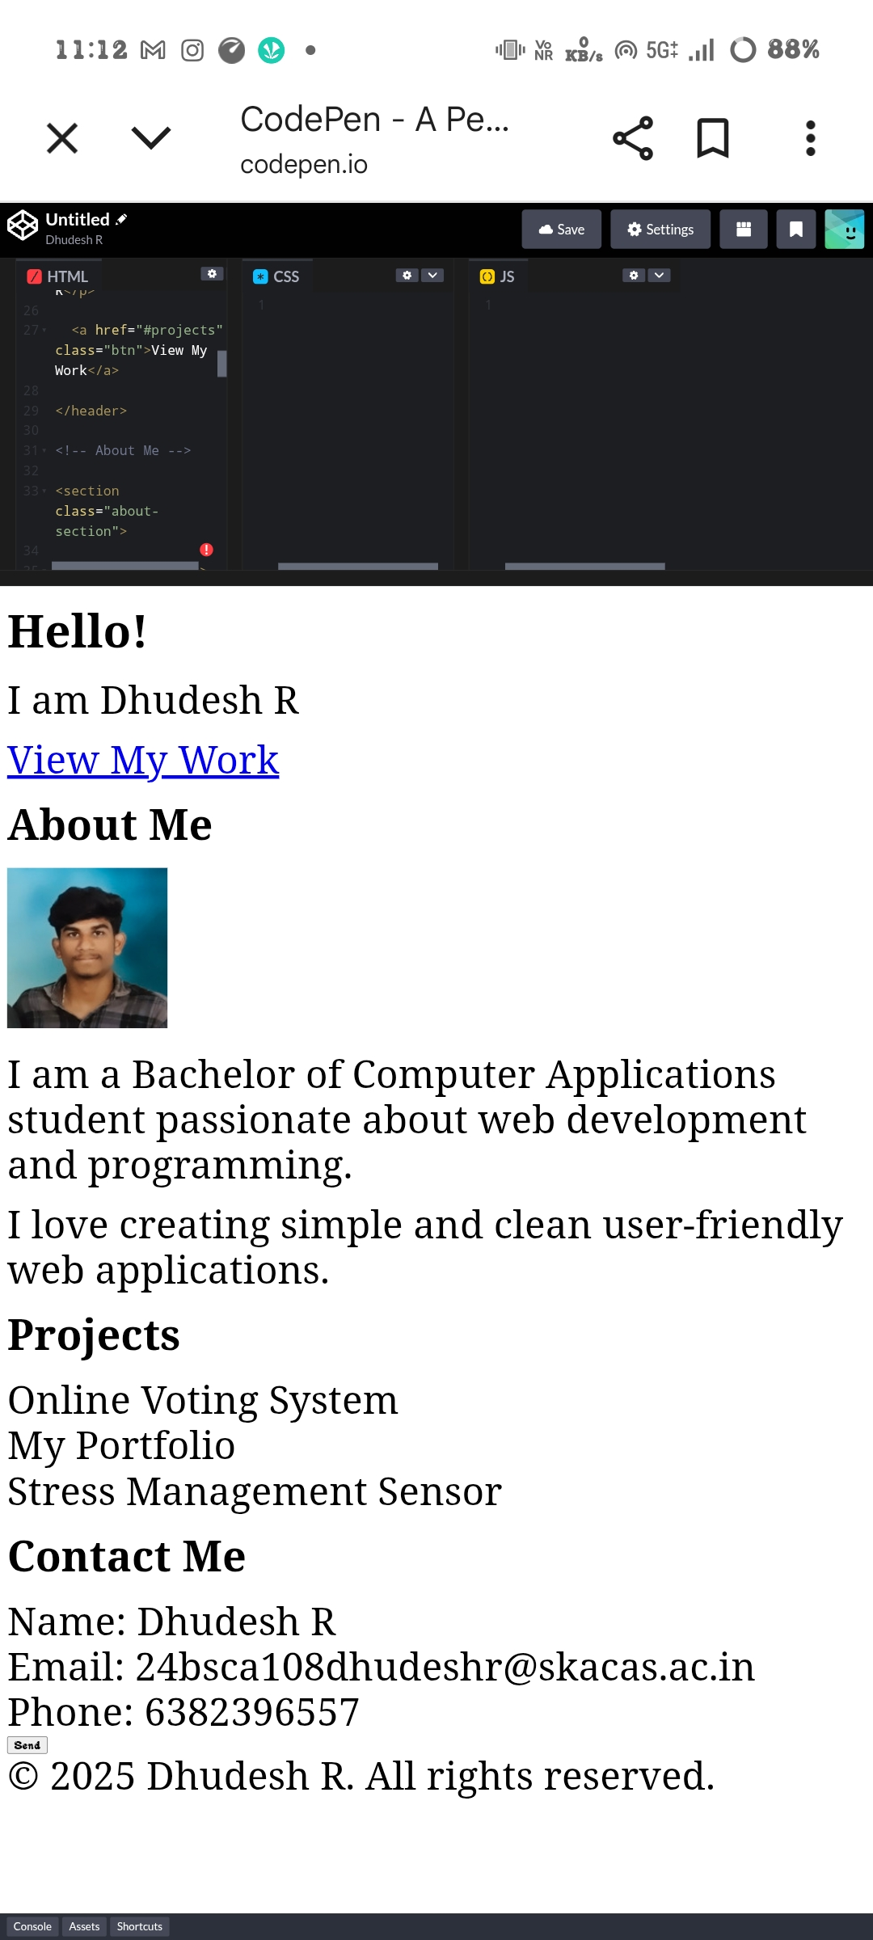

Slide 12
Built to showcase my skills in web development
Acts as a first step towards my professional online presence

